Slide 1
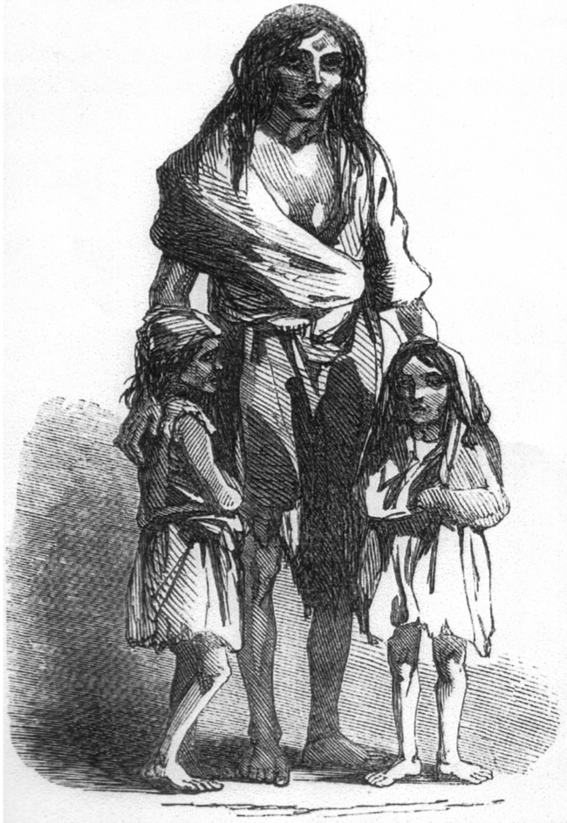
Great Irish Famine
1845-52
1 million deaths

Slide 2
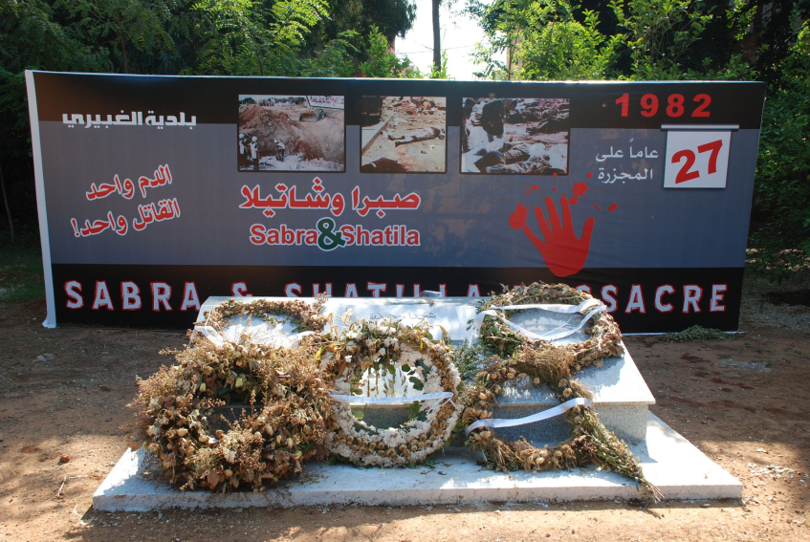
Sabra and Shatila massacre
Lebanon, 1982
3,500 deaths

Slide 3
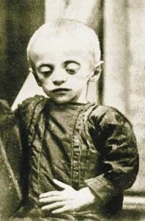
Holodomor
Ukraine, 1932-33
5-10 million deaths

Slide 4
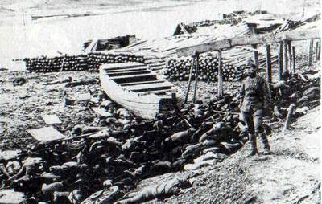
Japanese Invasion of China
1937-38
300,000 deaths
20,000 rapes

Slide 5
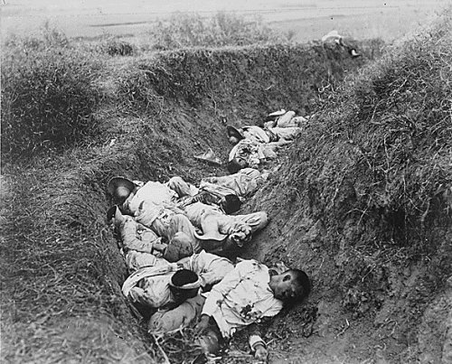
Philippine–American War
1899-1902
1.4 million deaths

Slide 6
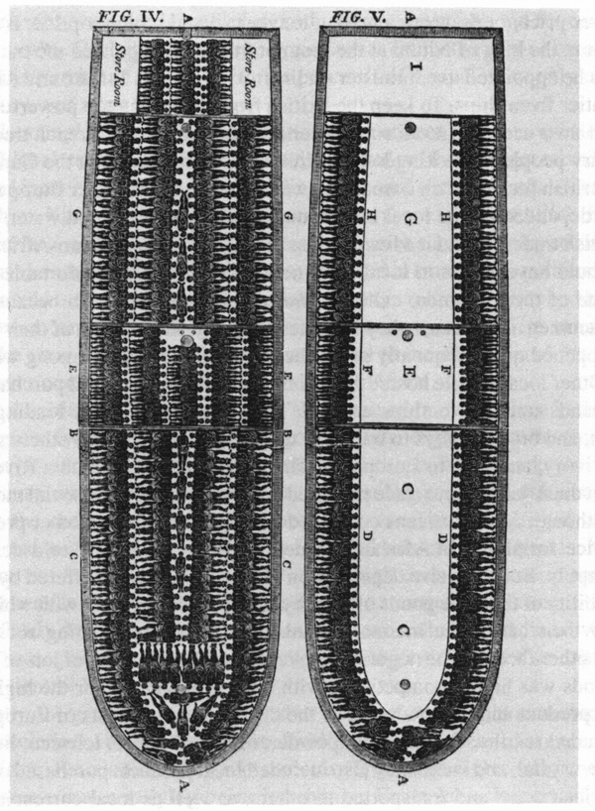
Transatlantic Slave Trade
16th – 19th Century
28 million deaths

Slide 7
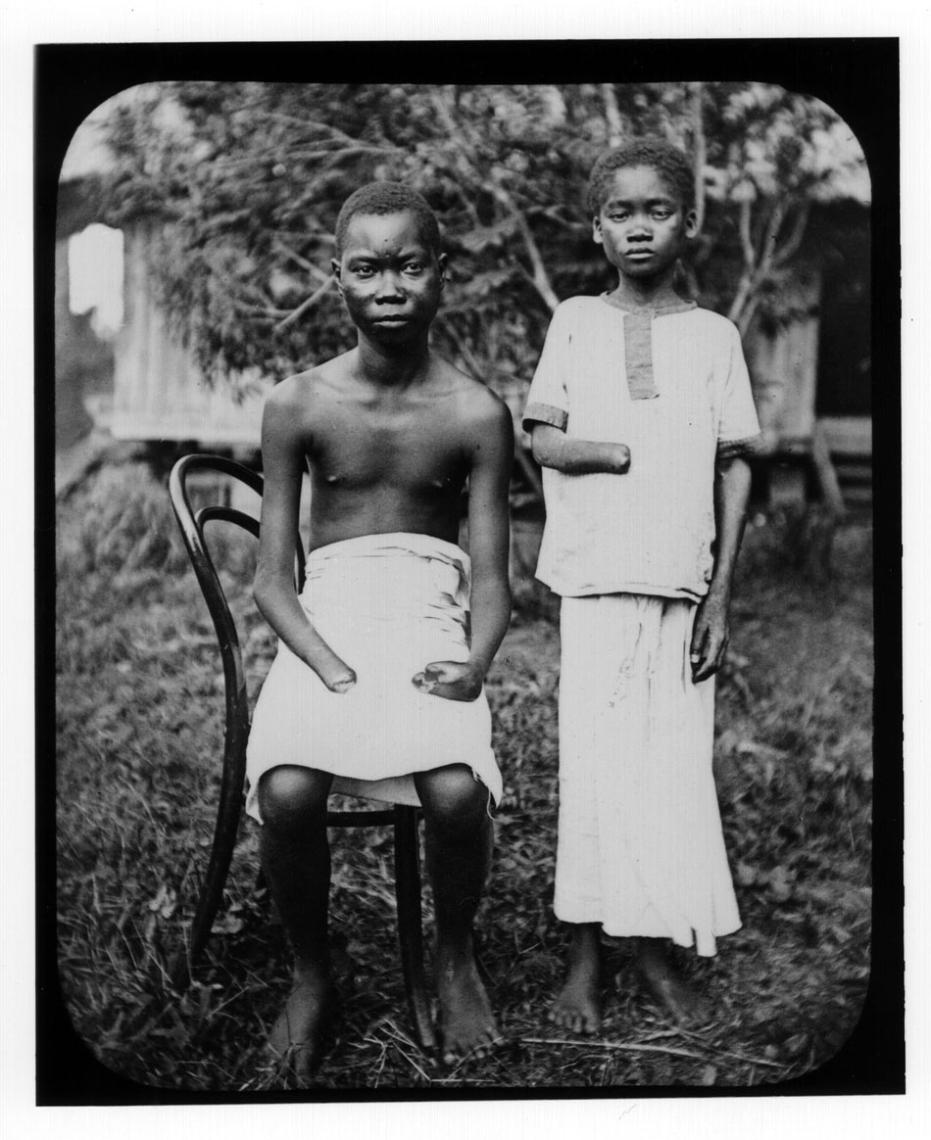
The Belgian Congo
1885-1912
8 million deaths;
half the population

Slide 8
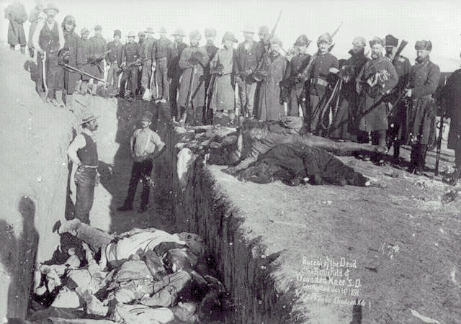
Native American Genocide
1492-1890
100 million deaths

Slide 9
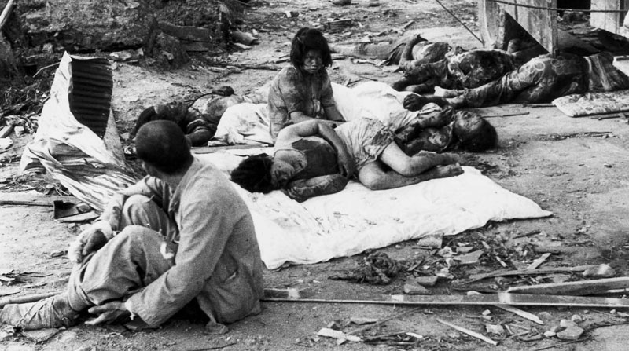
Atomic Bombings of Hiroshima and Nagasaki
1945
300,000 immediate deaths

Slide 10
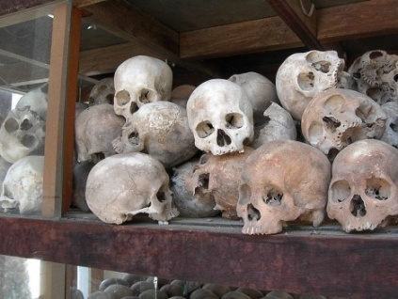
The Killing Fields
Cambodia, 1975-79
1.7 million deaths

Slide 11
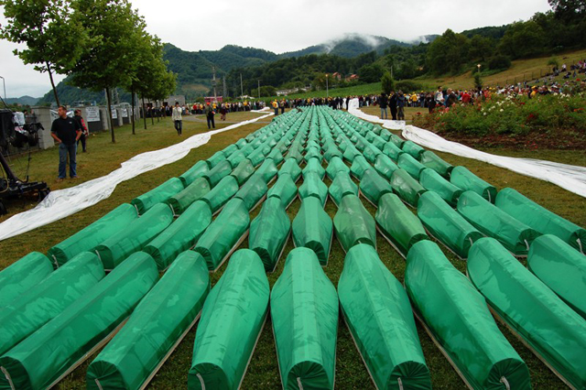
Srebrenica massacre
Bosnia, 1995
12,000 deaths

Slide 12
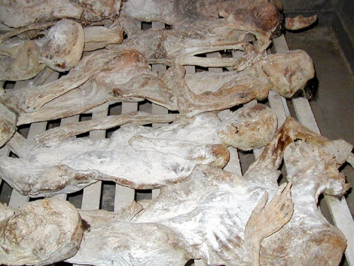
Rwandan Genocide
1994
850,000 deaths
Notes:
Cant use

Slide 13
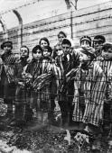
Nazi Holocaust
1939-45
11-17 million deaths,
including 6 million Jews

Slide 14
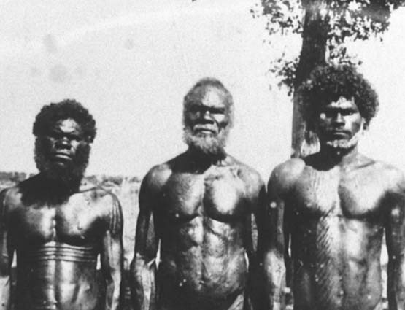
The Stolen Generations
Australia 1909-69
100,000 affected

Slide 15
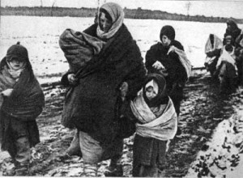
The Chechen Deportation
1944
500,000 affected,
Over 150,000 deaths

Slide 16
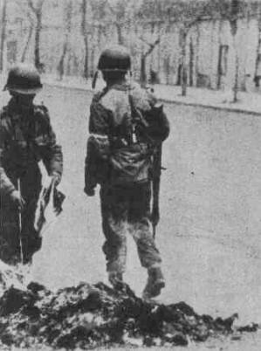
Chile under Pinochet
1973-90
3,500 deaths; 100,000 tortured;
200,000 exiled

Slide 17
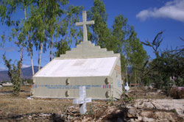
Guatemalan Civil War
1960-96
200,000 deaths
50,000 disappeared
Notes:
Cant use

Slide 18
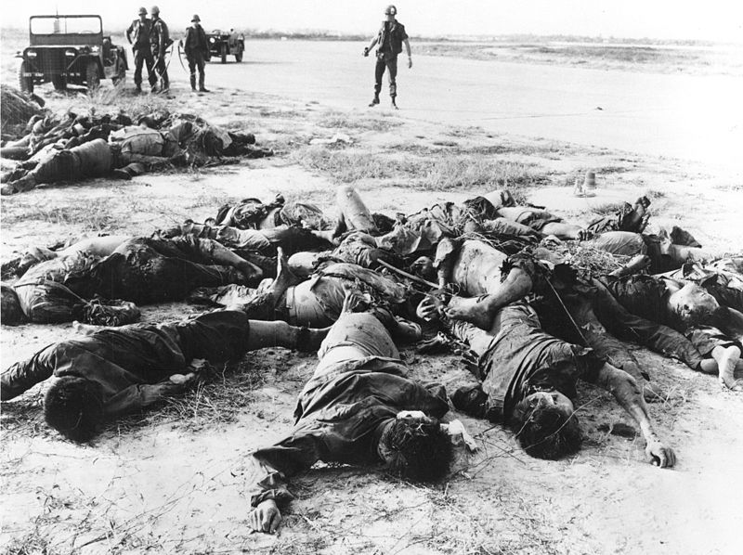
Vietnam War
1955-75
2.5 million deaths
Notes:
Cant use

Slide 19
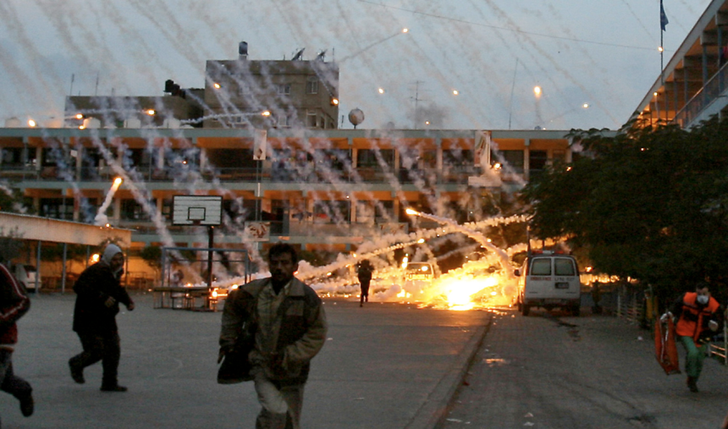
Israeli Assault on Gaza
Palestine, 2008-09
1,434 deaths; 5,303 injuries

Slide 20
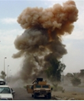
UN Sanctions and US/UK Bombing Raids
Iraq, 1990-2003
1.5 million deaths

