Slide 2
Recognition Awards
For Commitment to
Battling Islamophobia

Slide 3
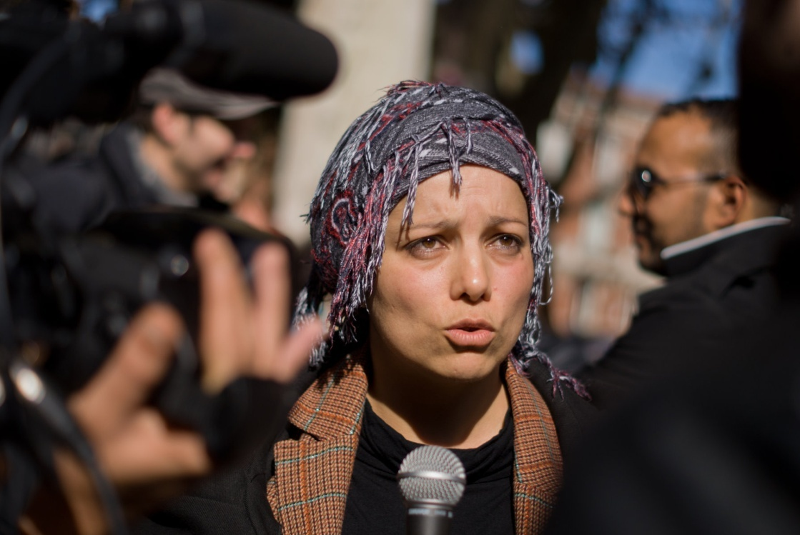
Houria Bouteldja
- She is, in her own words, an indigenous activist, subverting the often derogatively used word and wearing it as a badge of honour, a proud expression of her Algerian heritage within the French context.
- Born to immigrant working class parents, Houria grew up in France, and has since achieved great success by being singled out by the French Right as a bit of a rabble-rouser.
- She cuts a controversial figure, particularly in her role as spokesperson for the Party of the Indigenous Republic (formally the Movement of the Indigenous Republic, established in 2005). It is an anti-racist, anti-imperialist political party, which encourages "a space of self-organization for all those who want to engage in the fight against racial inequality that confines blacks, Arabs and Muslims similar to that of native status in the former colonies". Houria has come under attack by the French politicians for her role in encouraging a decolonial attitude to the country’s historical and contemporary legacy.
- In Houria’s multiple roles – as sociologist, speaker, activist, etc. She encourages us to reject the need for both categorisation and integration into a dominant culture. She speaks specifically about the situation of the Parisian suburbs: ‘To designate the youth…as a specifically violent category is a strategy aimed at confining us, Maghrebians and Blacks, in a representation that paints the foreigner, especially the Muslim foreigner, as retrograde and dangerous.’
- This award is in recognition of Houria’s tireless and uncompromising challenge to us all (from individuals to nation states): to decolonise.

Slide 4
Veterans for Peace
- A not-for-profit NGO established in the UK by veterans of wars including those in the Gulf, Northern Ireland, Bosnia, Afghanistan, and Iraq. The essential purpose of Veterans for Peace is, as the name suggests, the pursuit of peace. Their work is multi-pronged, and through non-violence actions aims to prevent overt and covert government intervention in the internal affairs of sovereign nations and abolish war as an instrument of national policy. They also aim to increase public awareness of the costs of war, highlight the benefactors of war, end the arms race and achieve global nuclear disarmament, and to seek justice for veterans and victims of war. No small feat.
- Members have had an active presence in a multitude of events this past year. They have held vigils for Chelsea Manning outside the US Embassy in support of her right to expose the follies of military action, protested at the USA’s use of Shannon Airport in its ‘War on Terror’ and the UK’s rendition programme, and joined the Occupy the Arms Fair protest at the Excel Centre here in London.
- Notably as well, Veterans for Peace have launched a movement called ‘Fast on Fridays’. In their own words, ‘the attack on the World Trade Centre in New York City on 11 September 2011 resulted in the deaths of 2996 people. In response to that attack, we in the west have unleashed our military might on Muslims around the world. We have killed hundreds of thousands of people. We have destroyed countless homes. We have locked up 1000s of men in numerous prisons and subjected them to torture.’ Members and supporters will be fasting on Fridays, 6am to 6pm, wearing orange wristbands and engaging people they meet on the day in discussions about the 166 men still held at Guantanamo Bay Naval Base and thousands more held in other prisons.
- This year marks the centenary of the start of the First World War. With the glorification of this horrendous loss of life already beginning, the role of Veterans for Peace will be more important than ever. Veterans for Peace member Ben Griffin elucidates resistance to this best: ‘Fight for Queen and country. What does that even mean? It is a jingoistic phrase dreamt up by some propaganda merchant intent on stoking the fire of that false religion: patriotism.’ For the always-important work they do, Veterans for Peace are being awarded tonight.

Slide 5
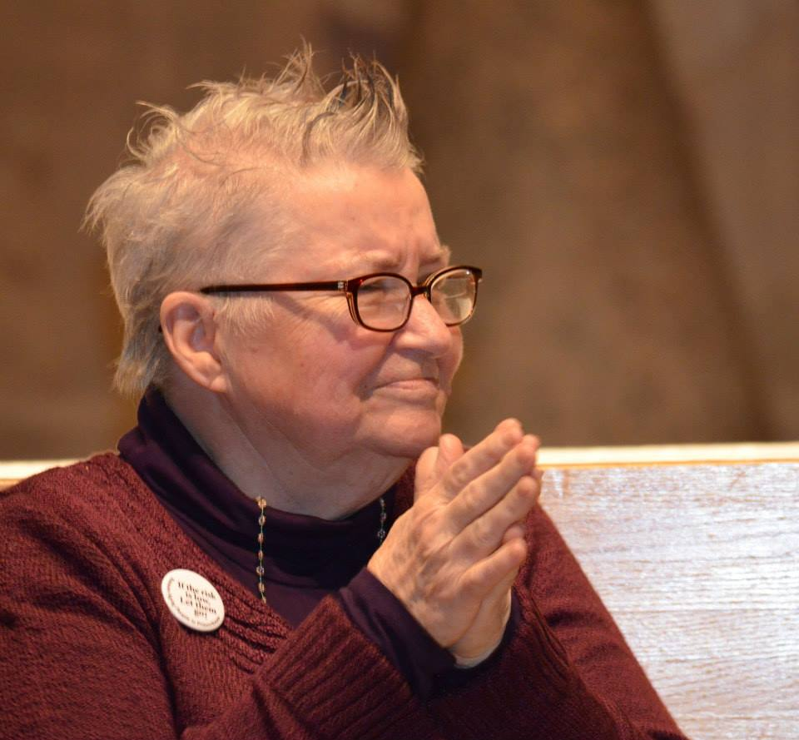
Lynne Stewart
- Lynne Stewart is a former human rights attorney who has devoted her life to the oppressed - an advocate for those in economic and political difficulty in the United States. She fought fiercely for her clients, including David Gilbert of the radical left movement ‘Weather Underground’, and the Black Panther activist Willie Holder.
- Lynne’s clients, like Lynne herself, tended to operate outside of the central political arena, challenging the authority of the State. Following the attacks on the World Trade Center on 11 September 2011, Lynne found herself in demand by Muslims increasingly targeted. Sheikh Omer Abdul Rahman was one of those she defended. Following his trial she was accused of passing messages on his behalf and thereby providing material support to terrorists. It was an obvious attempt by the U.S. government to silence dissent, curtail a vigorous defence lawyer seeking to help Arabs and Muslims being prosecuted for free speech, and instill fear in those who would fight against the U.S. government’s racism. She was convicted in 2006 and sentenced to 28 months in prison (a reduction from the initial proposition of 30 years). However, in late 2009 Lynne was re-sentenced to 10 years in federal prison. Lynne’s remarkable tenacity in the face of such adversity has been inspirational to many. Towards the end of last year she wrote a rallying message to her supporters: ‘be the champion who defends fearlessly… The forces of the empire are very busy removing the nerves, the hearts and guts of the Fifth Amendment and leaving it a shell of what it was and can be. We are the opposition that need to gather our shields and swords in its defense and be selfless and brave. Let us press forward – instead of the derision we often face, let us all strive to be…respected and honored.’
Due to the deterioration of her health and the subsequent lobbying for compassion by friends and family, she was released on 31 December 2013. On her release, Lynne confirmed she would be continuing to fight on behalf of female and political prisoners. ‘Fight on’, she said. ‘Don’t ever give in, resist, resist, resist.’
- For her passionate support for and continued fight on behalf of the downtrodden and marginalised, Lynne Stewart is presented with this award today.

Slide 6
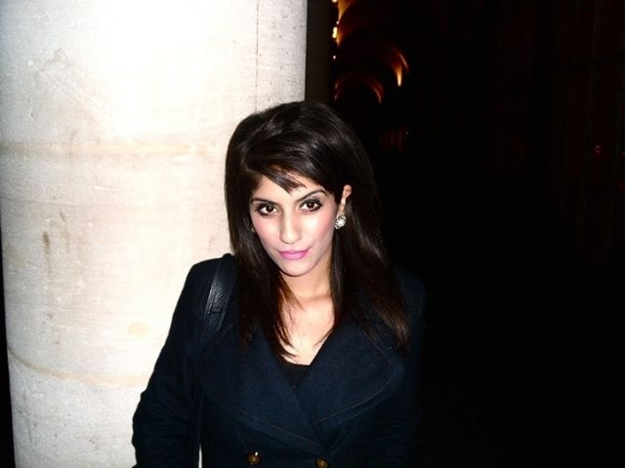
Katy P. Sian
- Katy P. Sian is a lecturer in sociology at The University of Manchester. Previously she was a postdoctoral research fellow at The University of Leeds where she also completed her PhD. She takes a key interest in debates surrounding racism and ethnicity studies, sociology, Sikh studies, Islamophobia, postcolonialism, Diaspora and South Asian identity.
- Katy launched a courageous book entitled Unsettling Sikh and Muslim Conflict : Mistaken Identities, Forced Conversions and Postcolonial Formations at IHRC last summer.
- Sian provided a critical investigation into Sikh and Muslim conflict in the postcolonial setting. Being Sikh in a diasporic context creates challenges that require complex negotiations between other ethnic minorities as well as the national majority. Unsettling Sikh and Muslim Conflict: Mistaken Identities, Forced Conversions, and Postcolonial Formations maps in theoretically informed and empirically rich detail the trope of Sikh-Muslim antagonism as it circulates throughout the diaspora. While focusing on contemporary manifestations of Sikh-Muslim hostility, the book also draws upon historical examples of such conflict to explore the way in which the past has been mobilized to tell a story about the future of Sikhs. This book uses critical race theory to understand the performance of postcolonial subjectivity in the heart of the metropolis.
- This award is in recognition of Katy’s challenge to racialised communities: to critically look at their conceptualisations of one other and not to fall for such ‘divide and rule’ tactics.

Slide 7
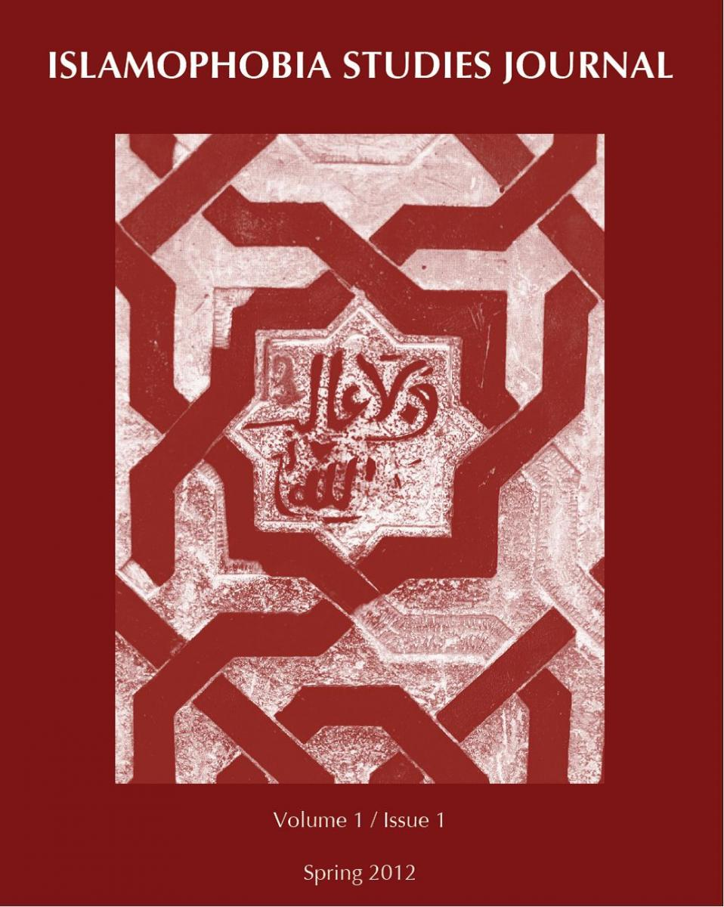
Islamaphobia Research and Documentation Project at the University of California - Berkeley
- The project focuses on a systematic and empirical approach to the study of Islamophobia and its impact on the American Muslim community.
- Today, Muslims in the U.S., parts of Europe, and around the world have been transformed into a demonized and feared global "other," subjected to legal, social, and political discrimination. Even at the highest levels of political discourse, the 2008 U.S. Presidential elections, Islamophobia took center stage as a sizeable number of Americans expressed fear that Barack Obama, the first African American president, is somehow a closet Muslim. Newspaper articles, tv shows, books, popular movies, political debates, and cultural conflicts over immigration and security produce ample evidence of the stigmatization of Islam within dominant culture.
- The challenge for understanding the current cultural and political period centers on providing a more workable and encompassing definition for the Islamophobia phenomenon, a theoretical framework to anchor present and future research, and a centralized mechanism to document and analyze diverse data sets from around the U.S. and in comparison with other areas around the world.
- The research agenda is centred on Muslims in the Diaspora and the intersection between two categories of inquiry: 1) race, ethnicity, gender, nationality, and religion, and 2) the global "war on terror," its impact on Muslim communities and American culture, and the use of the war to reintroduce long discredited Eurocentric paradigms. Part of the work includes publishing the Islamaphobia Studies Journal on the right.
- As IHRC has led the fight against Islamaphobic discourse in Britain, this award is given to the IRDP for its painstaking work in trying to deconstruct and challenge the discourse on Muslims and Islam across the pond at Britain’s most infamous settler colony, the United States.

