Slide 1
Europe & Central Asia

Slide 2
Europe & Central Asia

Slide 3
The Nominees
In no particular order
Notes:
They’re all Islamaphobes

Slide 4
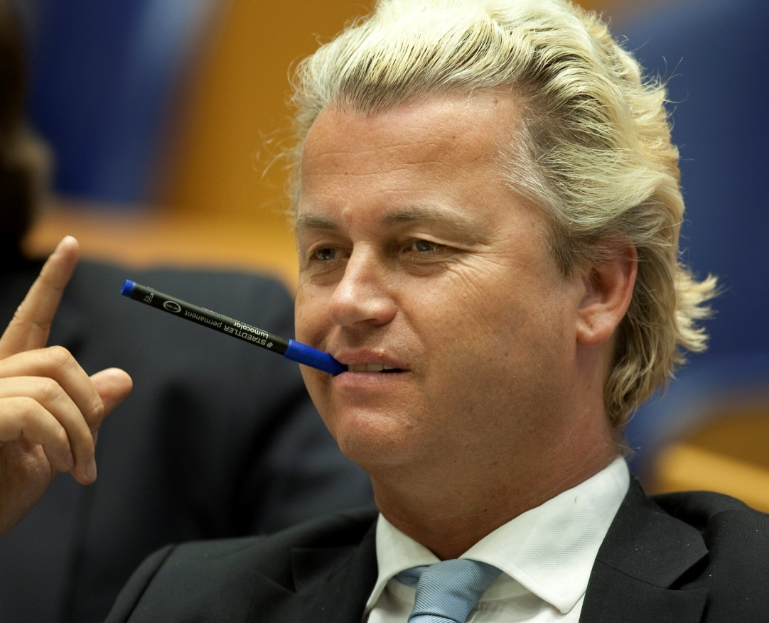
Geert Wilders (Netherlands)
- Form not long enough
- For creating the sticker saying in Arabic on the Saudi flag: ‘Islam is a lie, Mohammed is a criminal, the Koran is poison.’
- For chastising the Pope and asking him to “speak the truth about Islam – the largest threat to mankind in this present age”.
- For chastising Muslims thus: ”Muhammad was a warlord, terrorist and paedophile... If 1.5 billion people think he is the best example to follow it’s fair and necessary to analyse it and be able to talk about it.
- For chastising Muslims again: ”I call on all the Muslims in the world to leave Islam for Christianity or atheism or whatever they want. This will be good for them and also for our free society.”

Slide 5
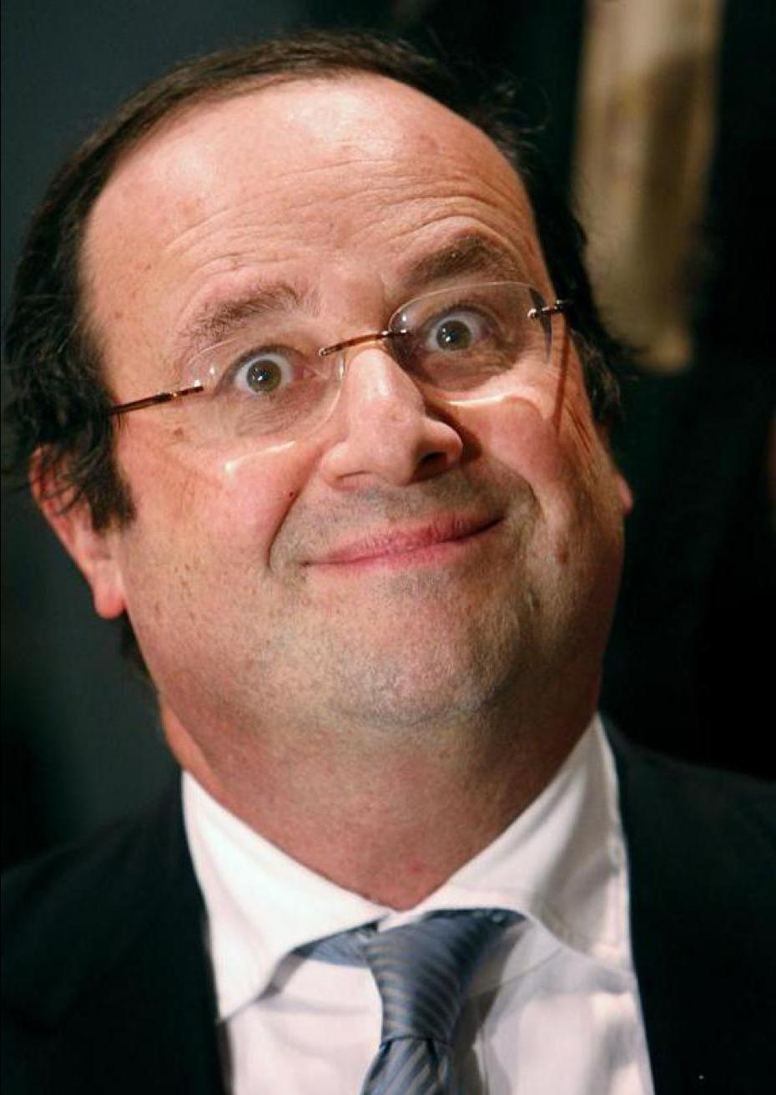
Francois Hollande (France)
- For invading Mali. By making the anti-Muslim war on terror just that little bit more French, Hollande’s intervention in the country resulted in what Amnesty’s Scott Edwards describes as ‘… deaths of civilians – including children – as a result of helicopter attacks, the mission findings told of horrific abuses by the Malian armed forces participating in the offensive made possible by French intervention… I found personally disturbing findings reminiscent of crimes committed in Darfur and elsewhere: the bodies of executed civilians thrown in water wells of Waïlurdé neighbourhood of Sévaré; civilians being stopped, arrested, and executed…’
- Hollande has this week however finally answered the 1 year call by Muslims in France to condemn Islamophobia, saying France owes a huge debt to the Muslim soldiers who dies for France in the First World, and that he condemns anti-Muslim acts.

Slide 6
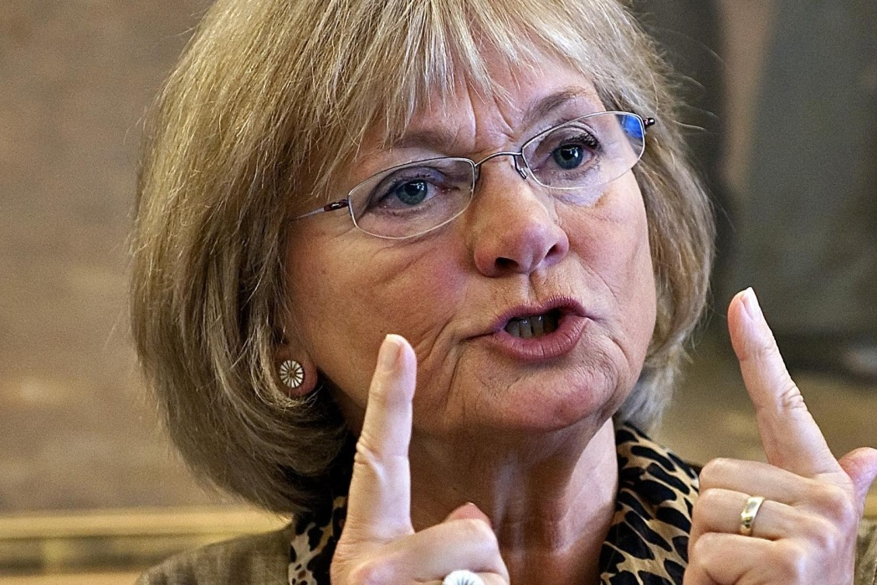
Pia Kjærsgård from the Danish Peoples Party (Denmark)
- For saying Muslims are at a "lower stage of civilization, with their own primitive and cruel customs..."
- She also published her autobiography last year that summarised her career long obsession with Muslims and ‘immigrants’

Slide 7
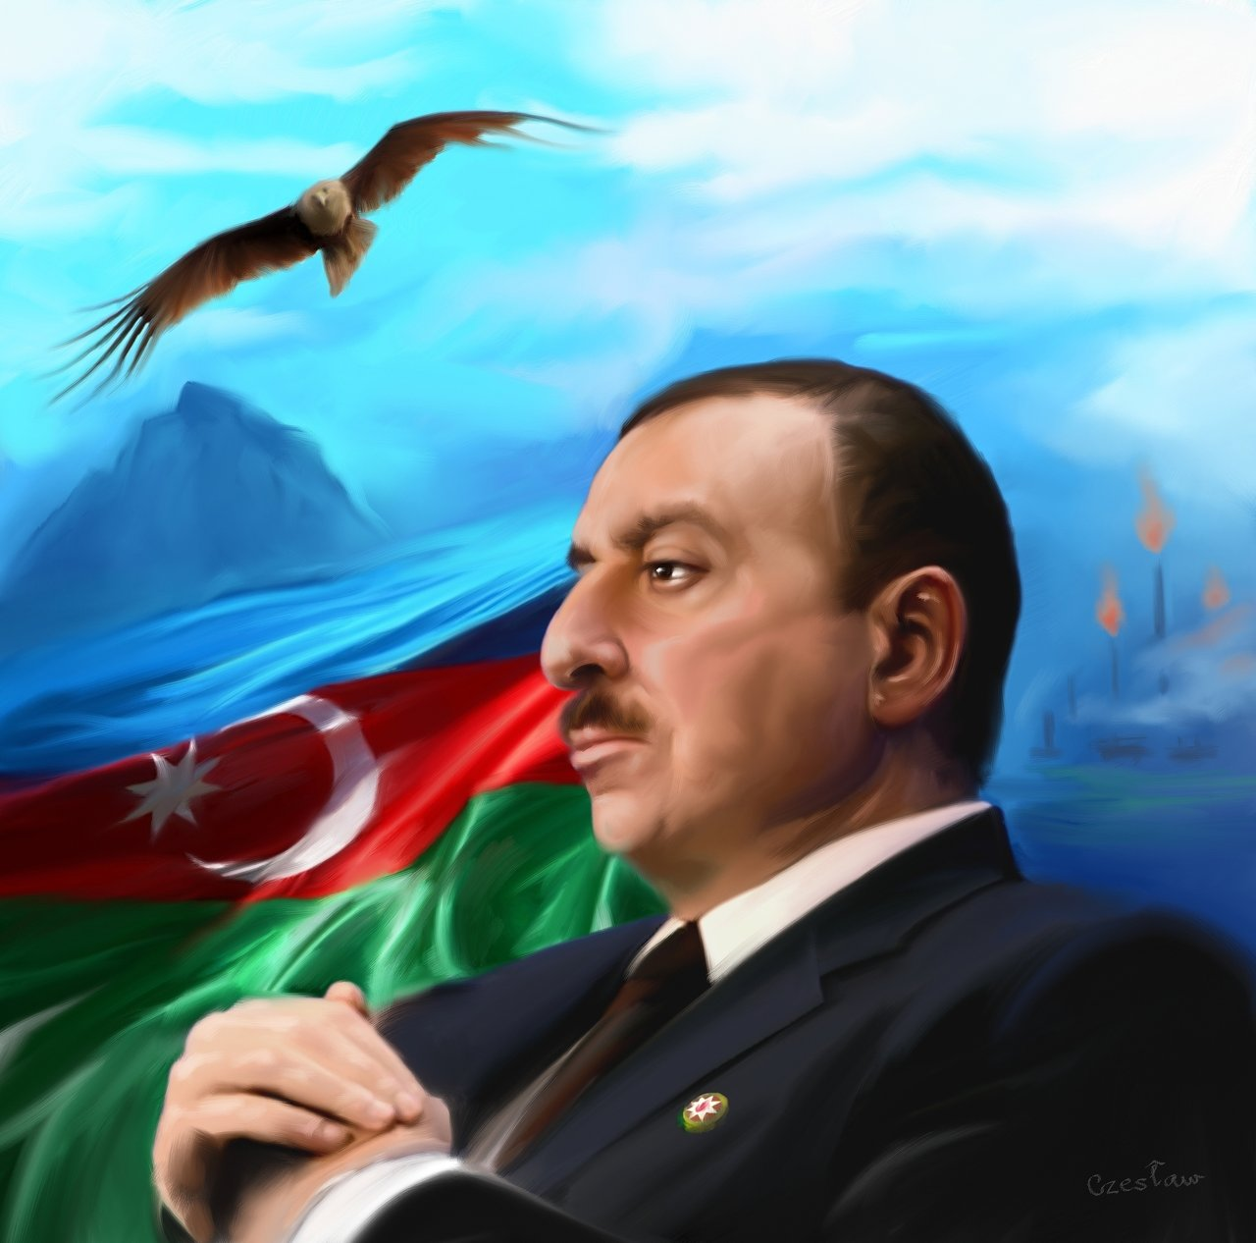
Ilham Aliyev(Azerbaijan)
- For banning iftar at mosques, arresting and imprisoning Imams, closing mosques, arresting activists, banning religious gatherings.

Slide 8
And the Winner is...

Slide 9
One of these...

Slide 10
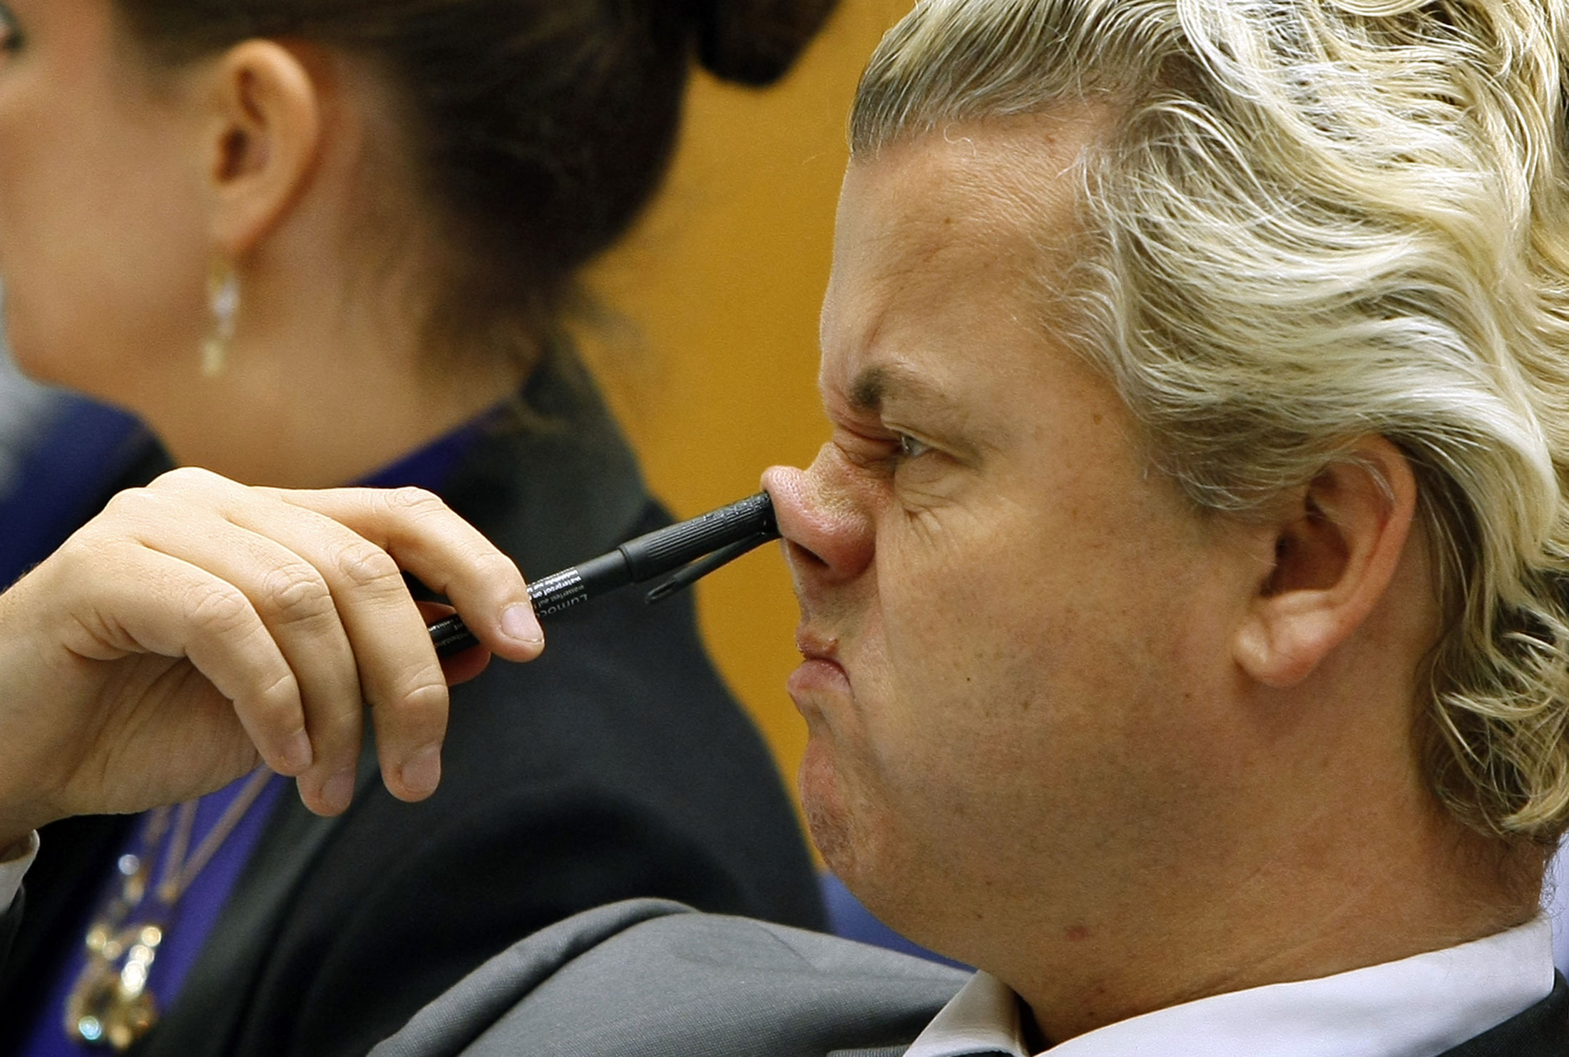
Geert Wilders

Slide 11
Middle East and Africa

Slide 12
The Nominees
In no particular order
Notes:
They’re all Islamaphobes

Slide 13
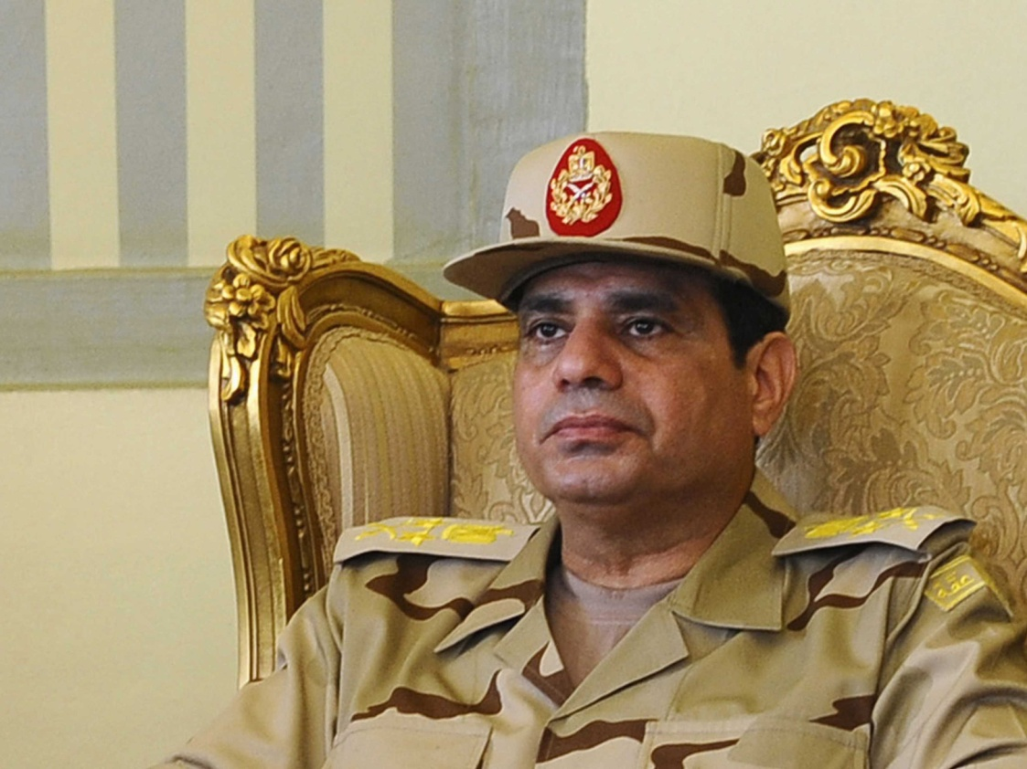
General al-Sisi (Egypt)
- For demonising the Muslim Brotherhood as terrorists and using that as a justification for the killing, tortures and arrests of thousands since the military coup in summer 2013.

Slide 14
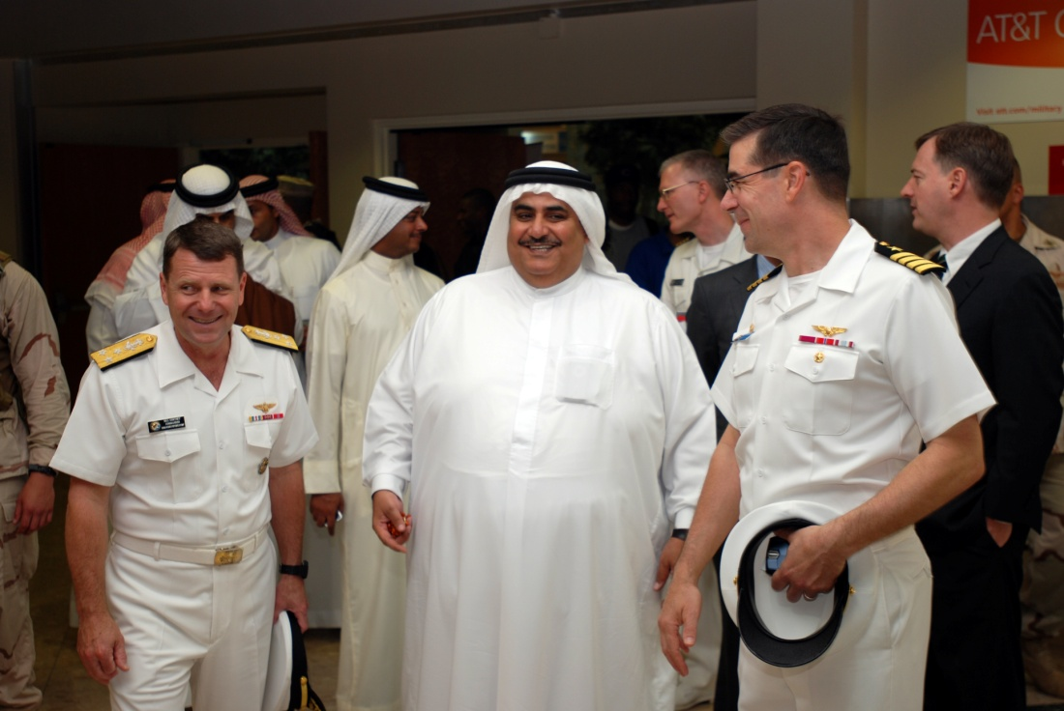
Al Khalifa Clan (Bahrain)
- For targeting Islamic centres, mosques and Imams of all backgrounds in their attempt to quell the Pearl revolution.

Slide 15
And the Winner is...

Slide 16
One of these...
Notes:
Wait for it:
General al-sisi or The Khalifa clan in Bahrain

Slide 17
Al-Sisi (Egypt)

Slide 18
The Americas

Slide 19
The Nominees
In no particular order
Notes:
They’re all Islamaphobes

Slide 20
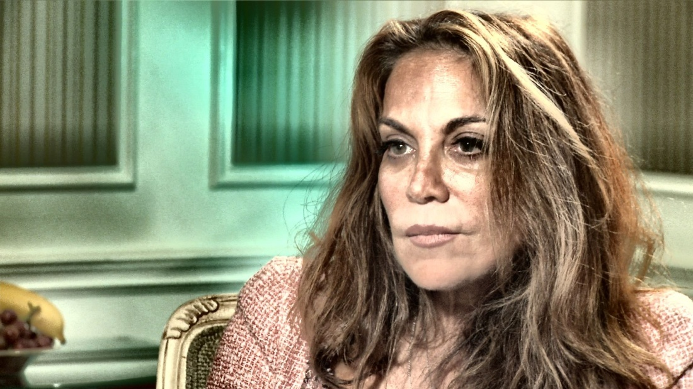
Pamela Geller (USA)
- For being America's Islamophobia Matriarch
- She has something to say about everything, including this year urging that Congress of not pass a resolution condemning attacks against Rohingya in Myanmar because ‘they were waging Jihad in Burma.’ She claimed the motion would be a “battering ram to impose Islam on small, defenceless countries.”
- Lambasting the Pope thus: “As Christians across the Muslim world live in abject terror and fear kidnapping, rape and slaughter to the bloodcurdling cries of ‘Allahuakbar,’ the pope gives papal sanction to the savage.”
- She has even condemned Daniel Pipes, a former winner, for being too moderate when talking about Muslims and saying there are some moderates, saying, she would “like to believe in unicorns and moonbeams but this fantasy is dangerous [sic] and Pipes has wasted too much time and money on a fallacy.”

Slide 21
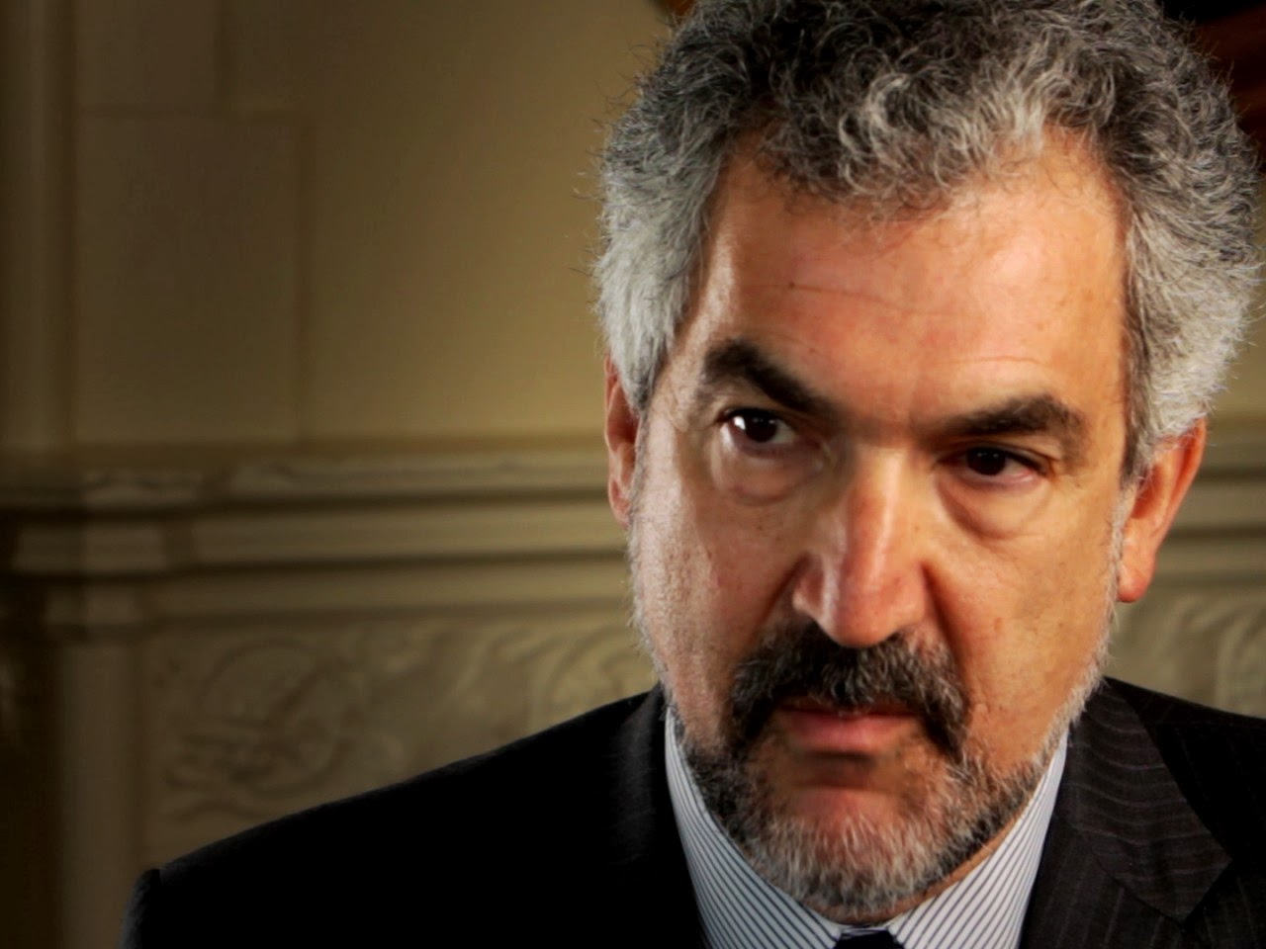
Daniel Pipes (USA)
- On the French rail crash last summer: “In this latest disaster in France, French Atlas readers tell me that Muslim “youths” were looting corpses at the train crash site. Most media neglected this monstrous bit of news; The Daily Telegraph makes a brief mention of the ghouls, referring to the Muslims as, ahem, “local people.”
- A previous winner who has now set up the Middle Eastern Forum funding so much of the Islamophobia Network in the USA

Slide 22
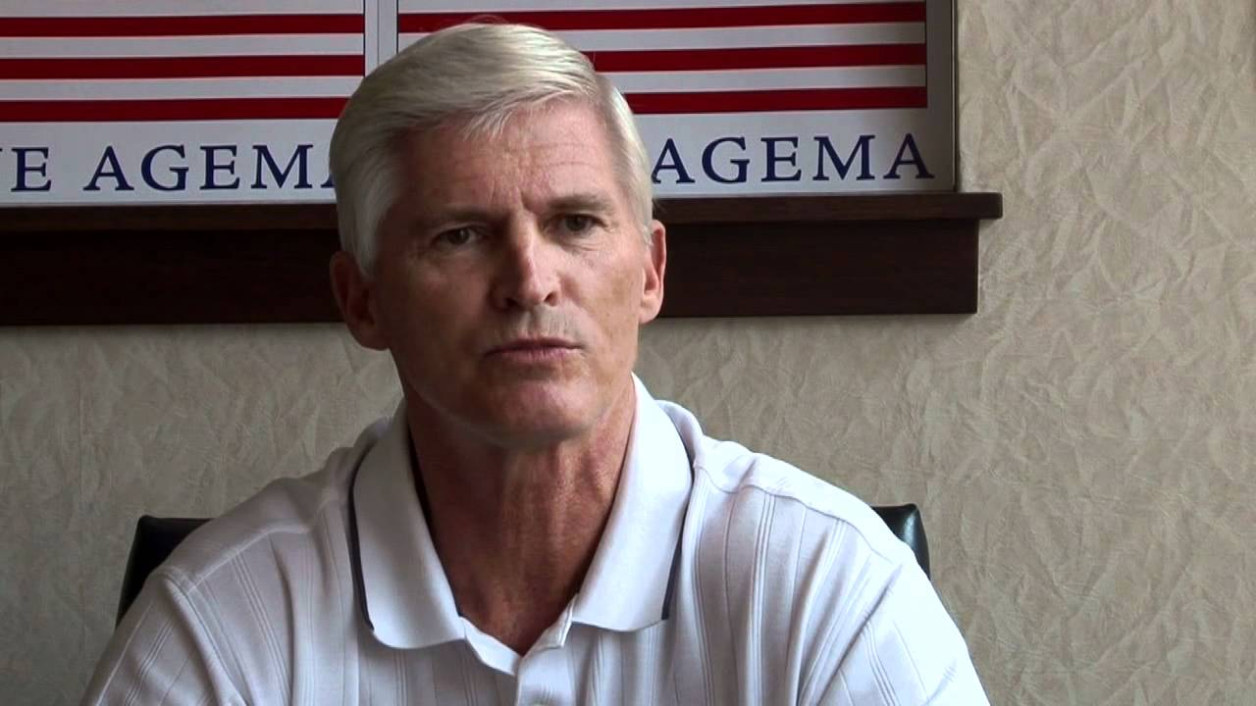
Dave Agema(USA)
- For saying "have you ever seen a Muslim do anything that contributes positively to the American way of life?"
- And for his "anti-Sharia bill"

Slide 23
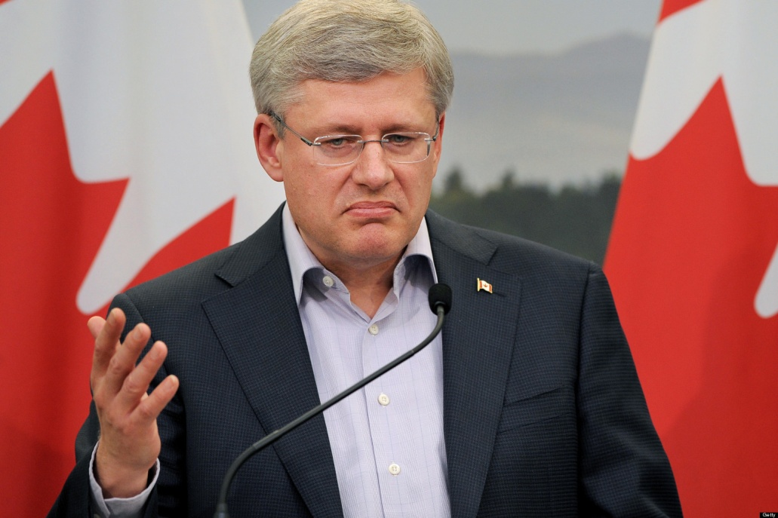
Stephen Harper (Canada)
- For Bill S-7: the Combating Terrorism Act and for saying 'Islamicism' as the biggest threat to Canada
- He also dismissed the UN Committee Against Torture (UN CAT) report that found Canada complicit in torture of Afghan detainees, and continued Canada’s role in rendition.
- When asked by leading human rights group the National Council of Canadian Muslims to rethink the inclusion of a delegation member in his trip to Tel Aviv, Harper responded, “We will not take seriously criticism from an organization with documented ties to terrorist organization such as Hamas.” He is currently being sued for libel.

Slide 24
And the Winner is...

Slide 25
One of these...
Notes:
Wait for it:
Pamela Geller, Daniel Pipes, Dave Agema, or Stephen Harper

Slide 26
Pamela Geller (US)

Slide 27
Asia and Australasia

Slide 28
The Nominees
In no particular order
Notes:
They’re all Islamaphobes

Slide 29
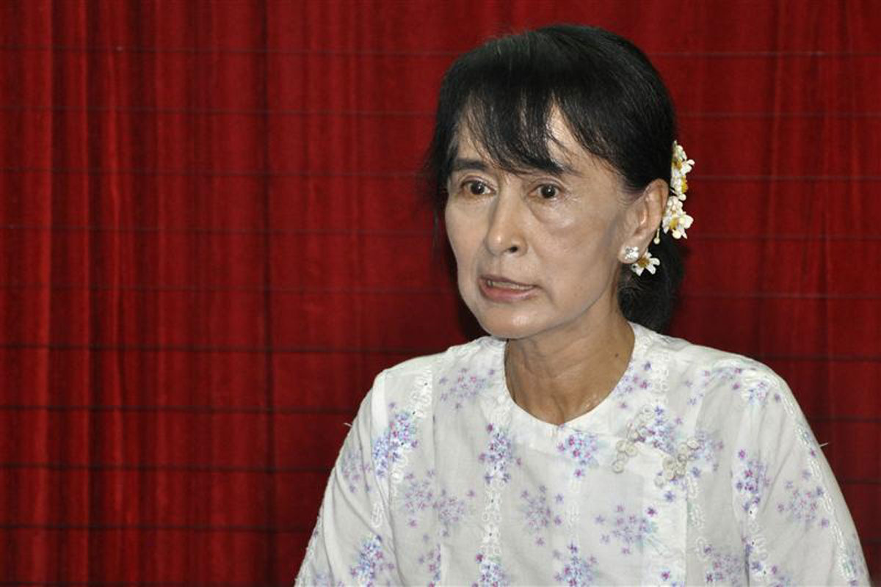
Aung San Suu Kyi (Myanmar)
- For failing to condemn outright racist/anti-Muslim violence in Myanmar.
- When asked to condemn it she has come up with many statements including providing context to the anti-Muslim violence as based on fear from Buddhists:
“You, I think, will accept that there’s a perception that Muslim power, global Muslim power, is very great and certainly that is the perception in many parts of the world and in our country too.” Muslims make up 4% of the Myanmar population.
- Or when asked to condemn Shin Wirathu, the anti-Muslim preacher who called all Muslims ‘dogs’ she stated only that: “I condemn hate of any kind.”
- When asked to specifically to condemn anti-Muslim violence in Myanmar she said: “I condemn any movement that is based on hatred and extremism.”
- She has also stated she did not know whether the Rohingya, a long established minority in Myanmar, and should be given back their citizenship stripped from their under the previous regime.

Slide 30
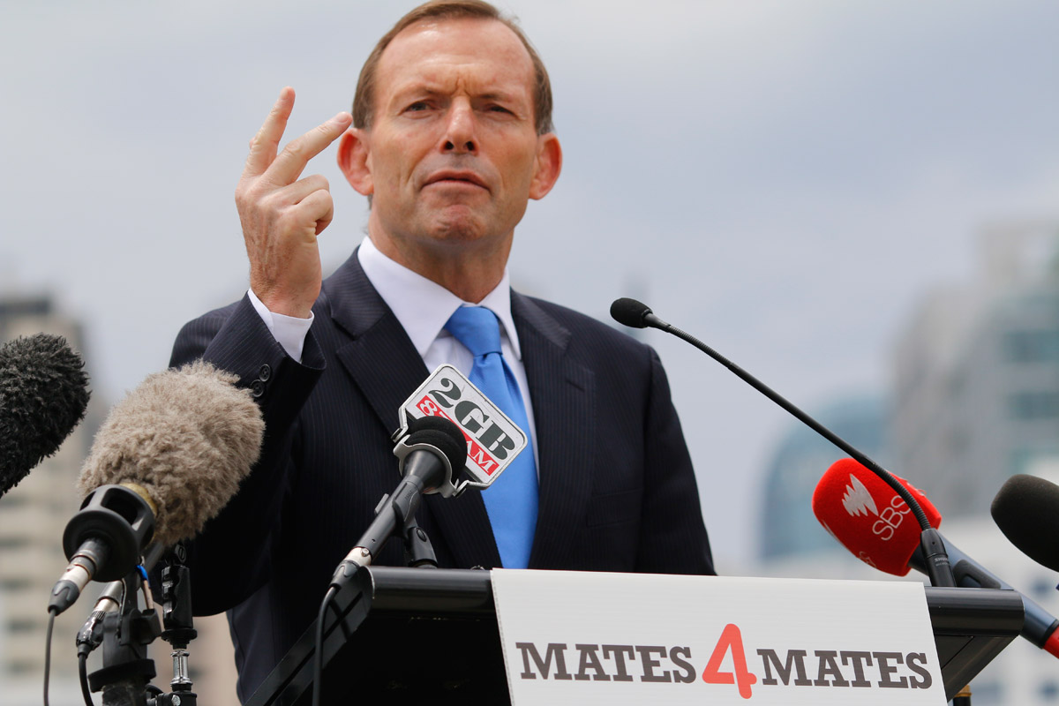
Tony Abbott (Australia)
- On the Niqab: ”Frankly, it’s not the sort of attire that I would like to see widespread in our streets”
- On Taji Mustafa’s trip to Australia: “I don’t think we need the preachers of hate in this country”
And: “We certainly shouldn’t be giving visas to people who are the people of hate.”
Whilst at the same time allowing Geert Wilders in because he was “entitled to his viewpoint.”
- On segregated seating: “I just think it’s un-Australian what’s happened here and I can’t understand for a second why Melbourne University would tolerate it”
On Syria: “It’s not goodies versus baddies, it’s baddies versus baddies and that’s why it’s very important that we don’t make a very difficult situation worse.”
- Held up by a woman with a shopping trolley, the following interchange takes place between Abbott and an old woman:
Old woman with a shopping trolley: I want to be in a country that’s not going to be run by Muslims.
Tony Abbott: I understand what you’re saying ma’am, and as I said the important thing is to make the borders secure and that way people will be happier that the right people are coming to our country.

Slide 31
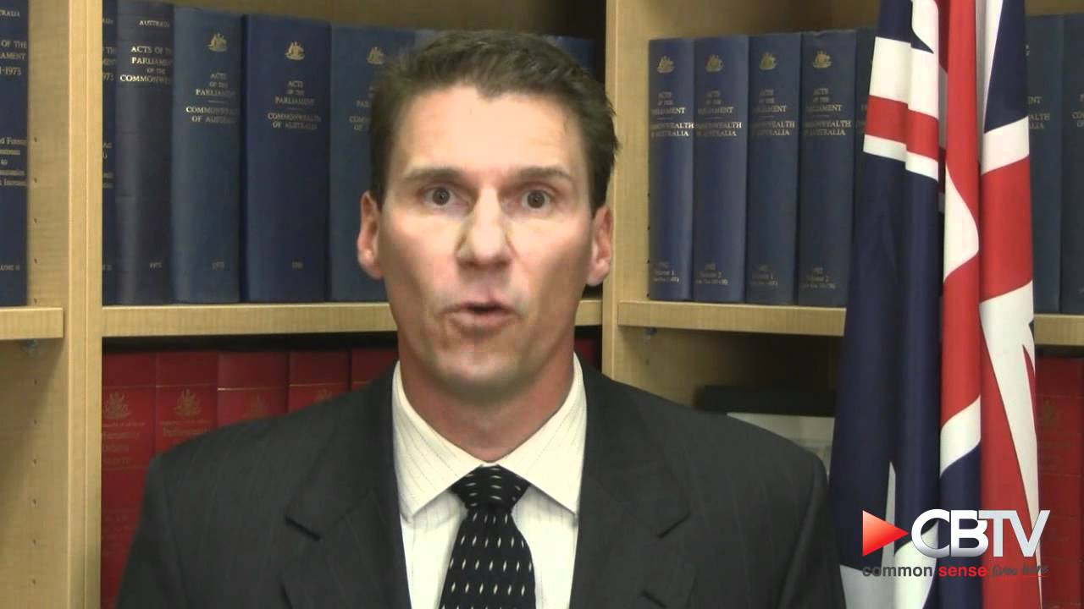
Cory Bernardi (Australia)
- For claiming Christianity is under siege from Islam (and the Greens). For stating in a written reply to an Australian Muslim that fundamentalist Islam has been linked to “gang rapes being justified by Muslim clerics” and “hate speeches being espoused in Australian mosques in the name of Allah” amongst a list of other allegations, and that:
- “You have identified yourself as an Australian Muslim. I would be interested to know if you subscribe to fundamentalist Islamic practices. If not, I ask then for evidence that you have publicly denounced the above mentioned practices and the preachers who advocate for non-engagement of Muslims and “infidels”
“In the absence of your condemnation, one could conclude you agree with their conduct. Accordingly, I will not be engaging in further correspondence with you.”

Slide 32
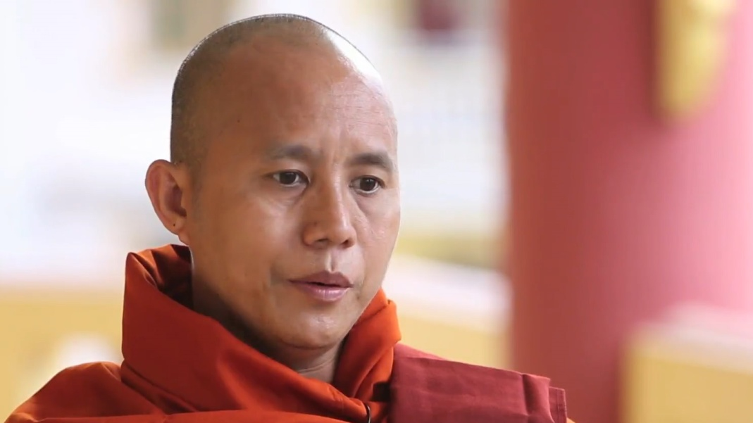
Shin Wirathu (Myanmar)
- Founder of the anti-Muslim movement 969
- “Muslims are only well behaved when they are weak. When they become strong, they are like a wolf or a jackal, in large packs they hunt down other animals.”
- “Over the past 50 years, we have shopped at Muslim shops and then they became richer and wealthier than us and can buy and marry our girls.”

Slide 33
And the Winner is...

Slide 34
One of these...
Notes:
Wait for it:
Aung San Suu Kyi, Tony Abbott, Cory Bernardi, or Shin Wirathu

Slide 35
Aung San Suu Kyi (Myanmar)

Slide 36
UK

Slide 37
The Nominees
In no particular order
Notes:
They’re all Islamaphobes

Slide 38
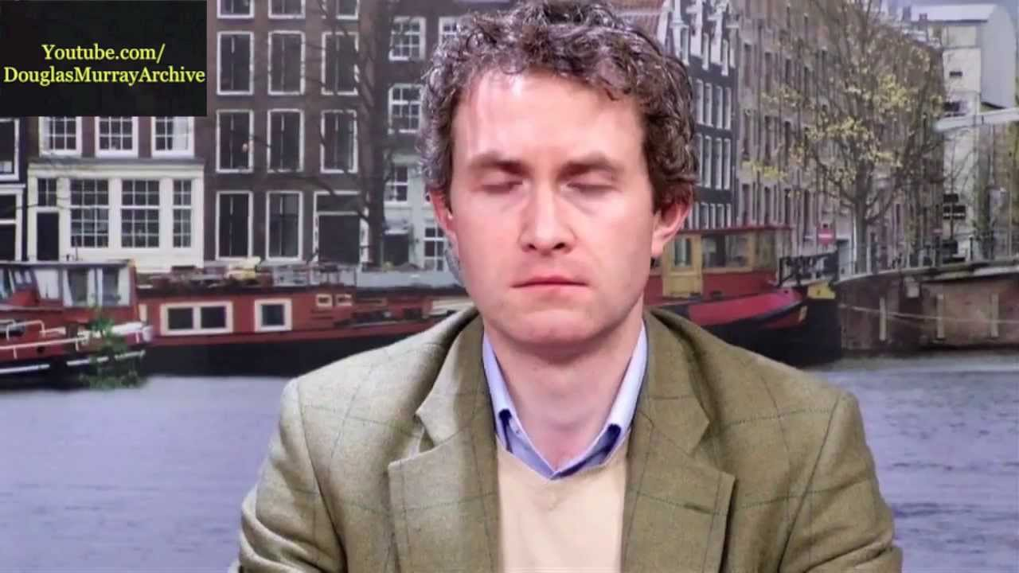
Douglas Murray
- For almost anything he has written about Islam and Muslims
- For example the article: “Is the startling rise in Muslim infants as positive as the Times suggests?”
- Or “The word Islamophobia" is a crock. A phobia is an irrational fear. Claustrophobia is irrational because small places tend not to kill you. On the contrary, it is highly rational to be afraid of some, though not all, interpretations of Islam. It is rational to be afraid of a Salafist. It is irrational to be afraid of an Ahmadiyya. But there are far more Salafists in the world today than there are Ahmadiyya.”
- Or “What is often called Islamophobia, on the other hand, is eminently solvable. Indeed, any real upsurge in suspicion or criticism of Islam can be stopped in an instant. For, if any suspicion of Muslims does exist it comes not because of some phantom but because of the behaviour of Islamic extremists, not least their suicidal conduct and ongoing war against Jews. If Muslims can eradicate the sickness of extremism, such as anti-semitism, from their faith then Islamophobia will become not only an unsatisfactory word, but a wholly an unneeded one.”

Slide 39
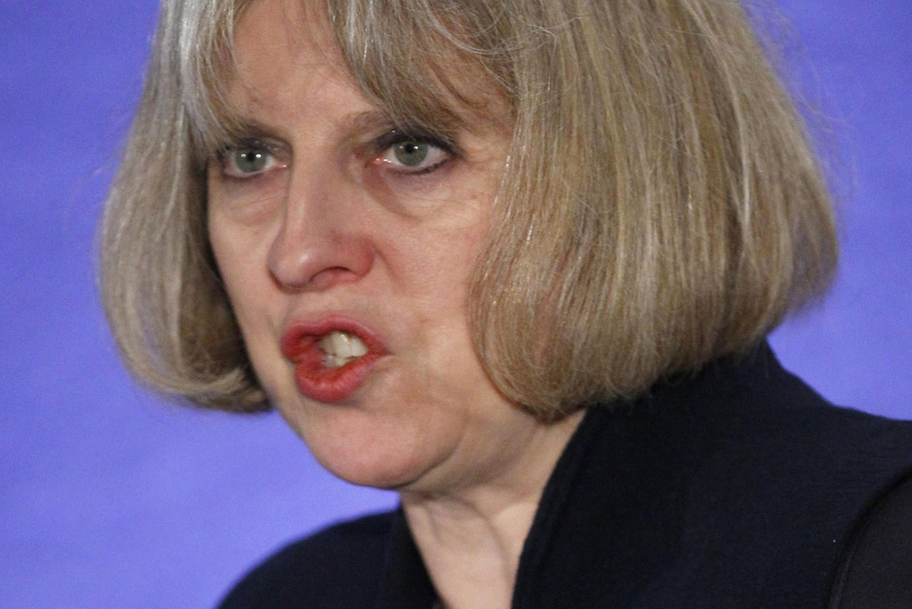
Theresa May, Home Secretary
- For the extradition of Asperger’s Sufferer Talha Ahsan whilst changing UK policy to allow another non-muslim Asperger’s sufferer Gary McKinnon to stay in the UK and not be extradited.
- For stripping 16 men of the British citizenship – most Muslim –two of whom were later killed in drone strikes

Slide 40
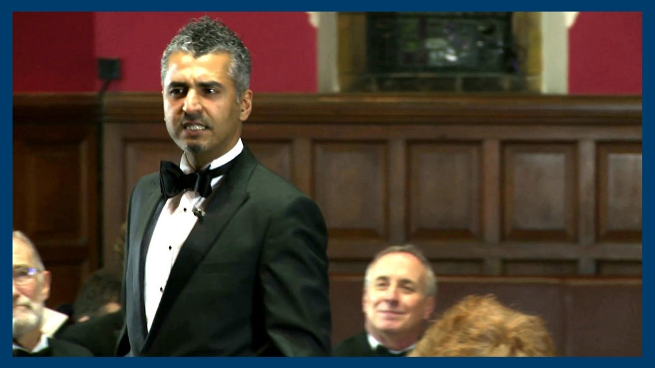
Majid Nawaz of Quilliam Foundation
- For allying himself and his organisation with the US including George Bush, the British Government, including Tony Blair and most recently Tommy Robinson and Kevin Carroll formerly of the English Defence League.
- For endorsing, promoting and accepting funding to promote the UK Government’s ideology of counter-extremism
- For saying that by seeking the Khilafah he was “abusing [his] faith for a mere political project” and then failing to realise the irony in then standing for the Lib Dems.
- For saying "The ideology of non-violent Islamists is broadly the same as that of violent Islamists; they disagree only on tactics.”
- For tweeting a picture of Prophets Muhammad (SAW) and Isa (AS) in another predictable publicity stunt to further his political career

Slide 41
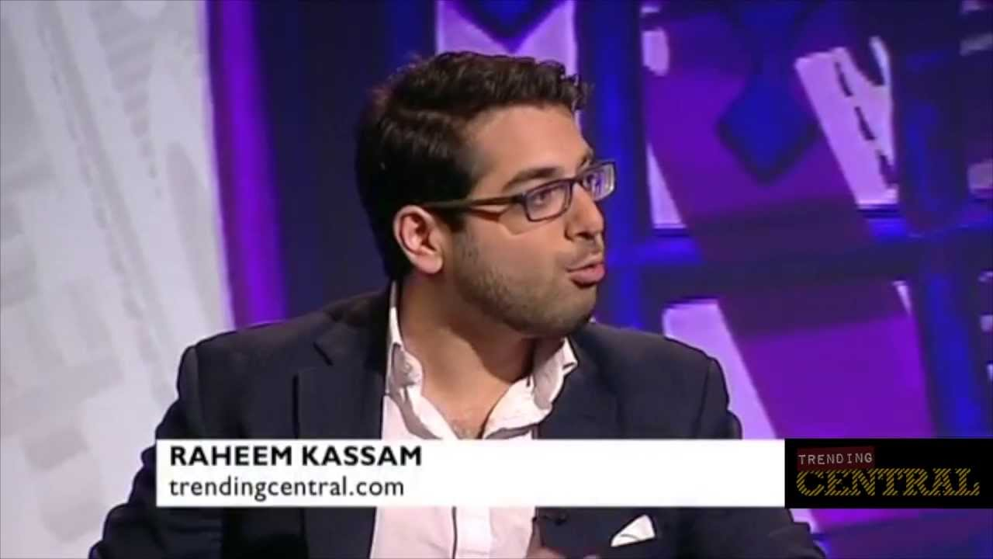
Raheem Kassam of Student Rights lobby group
- After a career working for Republicans in the US for their electoral campaigns, for endorsing, promoting, and accepting funding to promote the ideology of the right-wing think tank, the Henry Jackson Society
- For having the audacity to call gender segregation by choice in Islamic Society events gender apartheid... And then endorse the Apartheid state Israel’s policies against the Palestinians.
- For being “from a Muslim family” [yet in his view stating that he is] “someone whose upbringing was steeped in the dogma of group-think and mysticism ”

Slide 42
And the Winner is...

Slide 43
One of these...
Notes:
Wait for it:
Douglas Murray, Theresa May, Majid Nawaz or Raheem Kassam

Slide 44
Raheem Kassam

Slide 45
And last but not least
The Overall Winner is...
Notes:
Ask: who is it?

Slide 46
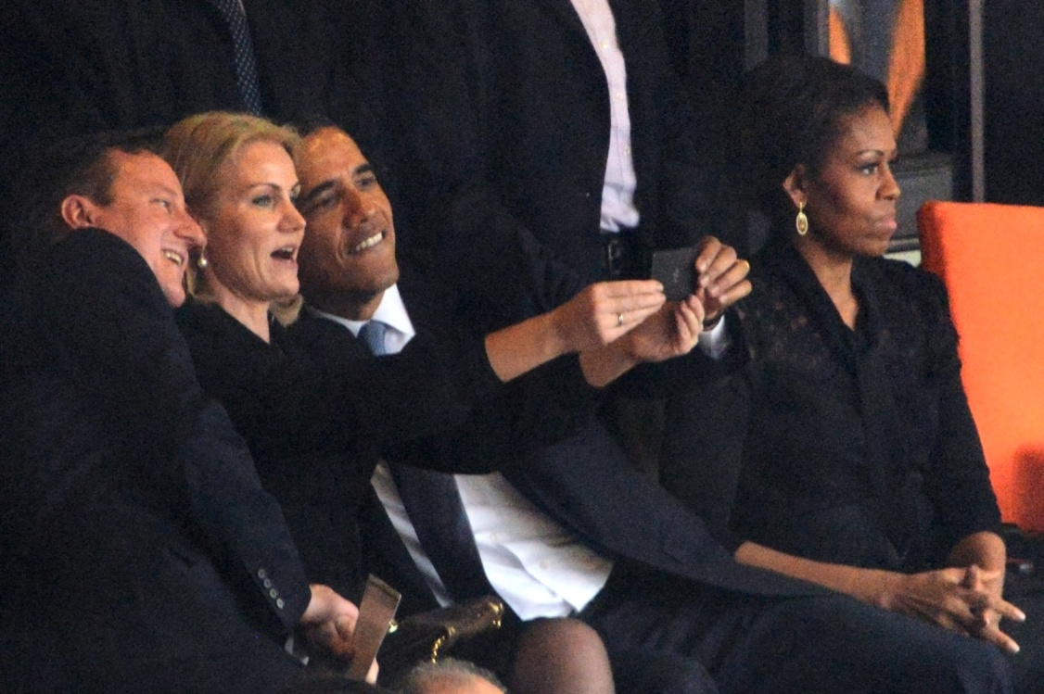
Barack Obama (USA)
- For not closing Guantanamo
- For continuing the war on terror
- For the drone strikes that take out Muslim men, woman and children and designating wedding guests as enemy combatants
- For “Guantanamising” the US through the National Defence Authorisation Act

