Slide 1
The Legacy of Enslavement
Thinking about the impact of the Transatlantic Slave Trade today
(English Language and Literature, Drama, History)
Ages 14+ and 16+
Notes:
Teachers can adapt the contents according to the subject taught and age of students. Themes including historiography, narrative, performance, biography, legacy, reparations and slavery. Overarching topics: Transatlantic Slave Trade and North American Colonialism.

Slide 2
Listen…
Watch this 15 minute video including a spoken word performance by Chicana, American, Muslim poet Mark Gonzales about the finding of the remains of 20,000 slaves buried on the site uncovered by the collapse of the World Trade Center on 9-11 (Quraishi, 2010).
Notes:
For non-US students discuss briefly what the term Chicana means.

Slide 3
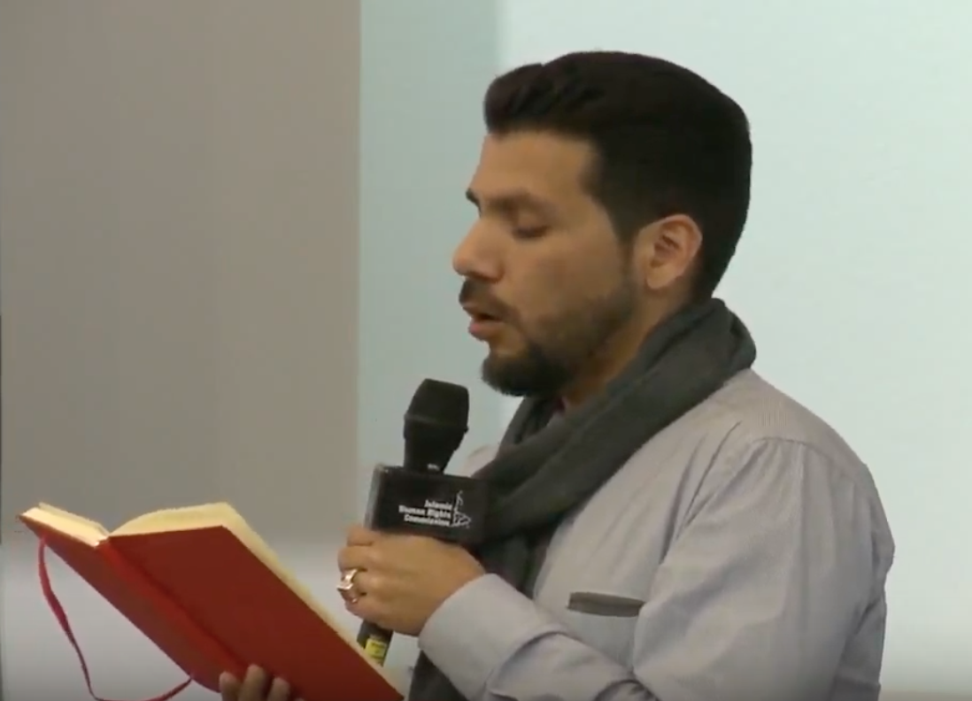
Mark Gonzales
Watch Gonzales piece
performed at
Genocide Memorial Day
in London, UK in 2013.
https://youtu.be/CFbzltsNHpo

Slide 4
Think and Discuss Three questions
What does Gonzales mean about reframing language?
What examples does the poet give of reframing language?
What examples of reframing language can you think of?
What is the difference between calling someone a slave and saying they are enslaved?
Notes:
Students can work in groups or 3 – 4 on one question and discuss amongst themselves for ten minutes before presenting their thoughts to the rest of the class.

Slide 5
How does reframing apply to what the poet is talking about regarding the burial site?
How does he feel connected those buried there?
Is this a surprise to you? If so, why?
How are those buried there remembered by (i) society; (ii) the poet?

Slide 6
3. How does the story of those slaves impact the life of the poet and the lives of people of colour today?
Who is still impacted by the Transatlantic Slave Trade today?
How does the poet feel impacted? Who does he say still feels the effects?
What are these effects?

Slide 7
Follow up
In small groups, research and find about about the work of organisations working on the legacy of slavery today
In small groups compose and perform a short poem or piece of prose about the legacy of the Transatlantic Slave Trade
Individually, write 150 – 200 words on the social impact of slavery in today’s world
Individually or in groups ‘reframe’ a phrase or term to do with slavery. Discuss what impact that has on the meaning of the term?
Notes:
Teachers can refer students to sites like ‘Stop the Maangamizi: We Charge Genocide/Ecocide!’ or the CARICOM Reparations Committee http://caricomreparations.org.

Slide 8
Bibliography
Quraishi, Jen. (2010) Ground Zero’s Slave Graves, https://www.motherjones.com/politics/2010/08/ground-zero-was-built-graves-slaves/
Small, Stephen and Hira, Sandew. (2014) 20 Questions and Answers about Dutch Slavery and its Legacy, Amrit
Nimako, Kwame and Willemsen, Glen (2011) The Dutch Atlantic: Slavery, Emancipation and Liberation, Pluto.

